Slide 1
Technical Interview Preparation Session #N

Slide 2
What is TIPS?
Purpose: Prepare UF students to achieve their professional goals
You will practice both behavioral and technical interview skills
You will learn about different companies, their cultures, and how they conduct their interviews

Slide 3
How to do behavioral interview
Follow the STARR interview process:
S: Situation
T: Task
A: Action
R: Result
R: Reflection
Example:
TODO
Notes:
Tell me about a time when you worked on a team and had to deal with someone difficult
Tell me about a time you convinced someone, or a group of people, to adopt one of your ideas

Slide 4
How to do a technical interview
Ask clarifying questions about problem statement (5 min)
Think about solutions (15 min)
Write your solution, iterate, and speak about it (20 min)
Test your solution (3 min)
State time complexity and how to make it a better algorithm ( 2 min)

Slide 5
How to tackle first seeing the problem:
Ask clarifying questions
Ask about constraints Ex: (What is the highest/lowest value)
Ask about any edge cases Ex: (In a problem about sorting ask if all values will be valid)
Interviewers usually don’t tell you the full scope of the problem to make you ask those questions

Slide 6
How to tackle first seeing the problem:
Thinking of a solution
Think of the brute force solution first
Iterate on solution and see what you can optimize
Speak clearly and precisely
If you are stuck, you can leverage your interviewer and ask if you are going in the right direction

Slide 7
Writing your solution
Speak clearly about what you are writing down to let the interviewer know how you are approaching your solution
Use helper functions!!
Use a coding style and stick with it
Use proper naming of variables
Depending on company/interviewer: use them as guides or support
If writing pseudocode, try to abbreviate any common actions
I.e popping from a stack, sorting (if it’s not the main problem)

Slide 8
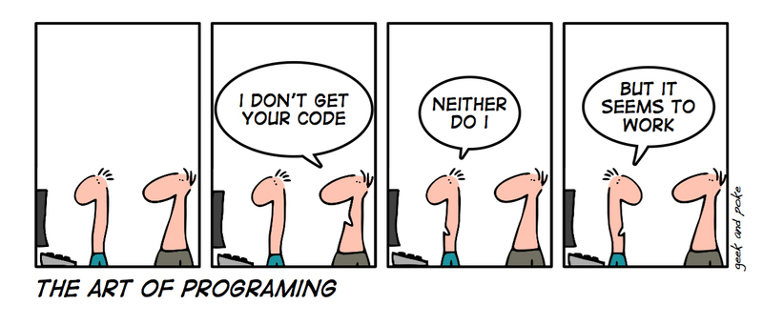
Testing your solution
Go through a few test cases with your interviewer
This helps the interviewer understand your code
Verifies if solution is robust
State time complexity

Slide 9
How to be a good interviewer?
Listening is key. Try to understand the interviewee’s thought process.
Read through the problem and its solution in its entirety.
Being supportive and kind.
Try to have a conversation with the interviewee.
Try to put the interviewee at ease.
If they are struggling for a while, ask if they would like a hint.

Slide 10
The ✨Company Part ✨

Slide 11
Structure of TIPS
~60 minutes total
--- Break into pairs
5 minutes get to know you and behavioral question
20 minutes technical interview question
5 minutes to go over the solution and what could be improved
--- Switch roles
5 minutes behavioral question
20 minutes technical interview question
5 minutes to go over the solution and what could be improved
~2 minutes fill out survey and get credit for Hire Thy Gator Quiz

